Slide 1



Slide 2










Slide 3










Slide 4




Slide 5


Slide 6





Slide 7








Slide 8
// Logs all actions and states after they are dispatched. const logger = store => next => action => { console.group(action.type)
console.info('dispatching', action) let result = next(action)
console.log('next state', store.getState()) console.groupEnd()
return result
}

Slide 9



Slide 10
















Slide 11









Slide 12

export function deleteAuthor(authorId) { return dispatch => {
return AuthorApi.deleteAuthor(authorId)
.then(() => {
dispatch(deletedAuthor(authorId));
})
.catch(handleError);
};
}

Slide 13
export function deleteAuthor(authorId) { return (dispatch, getState) => {
return AuthorApi.deleteAuthor(authorId)
.then(() => {
dispatch(deletedAuthor(authorId));
})
.catch(handleError);
};
}

Slide 14
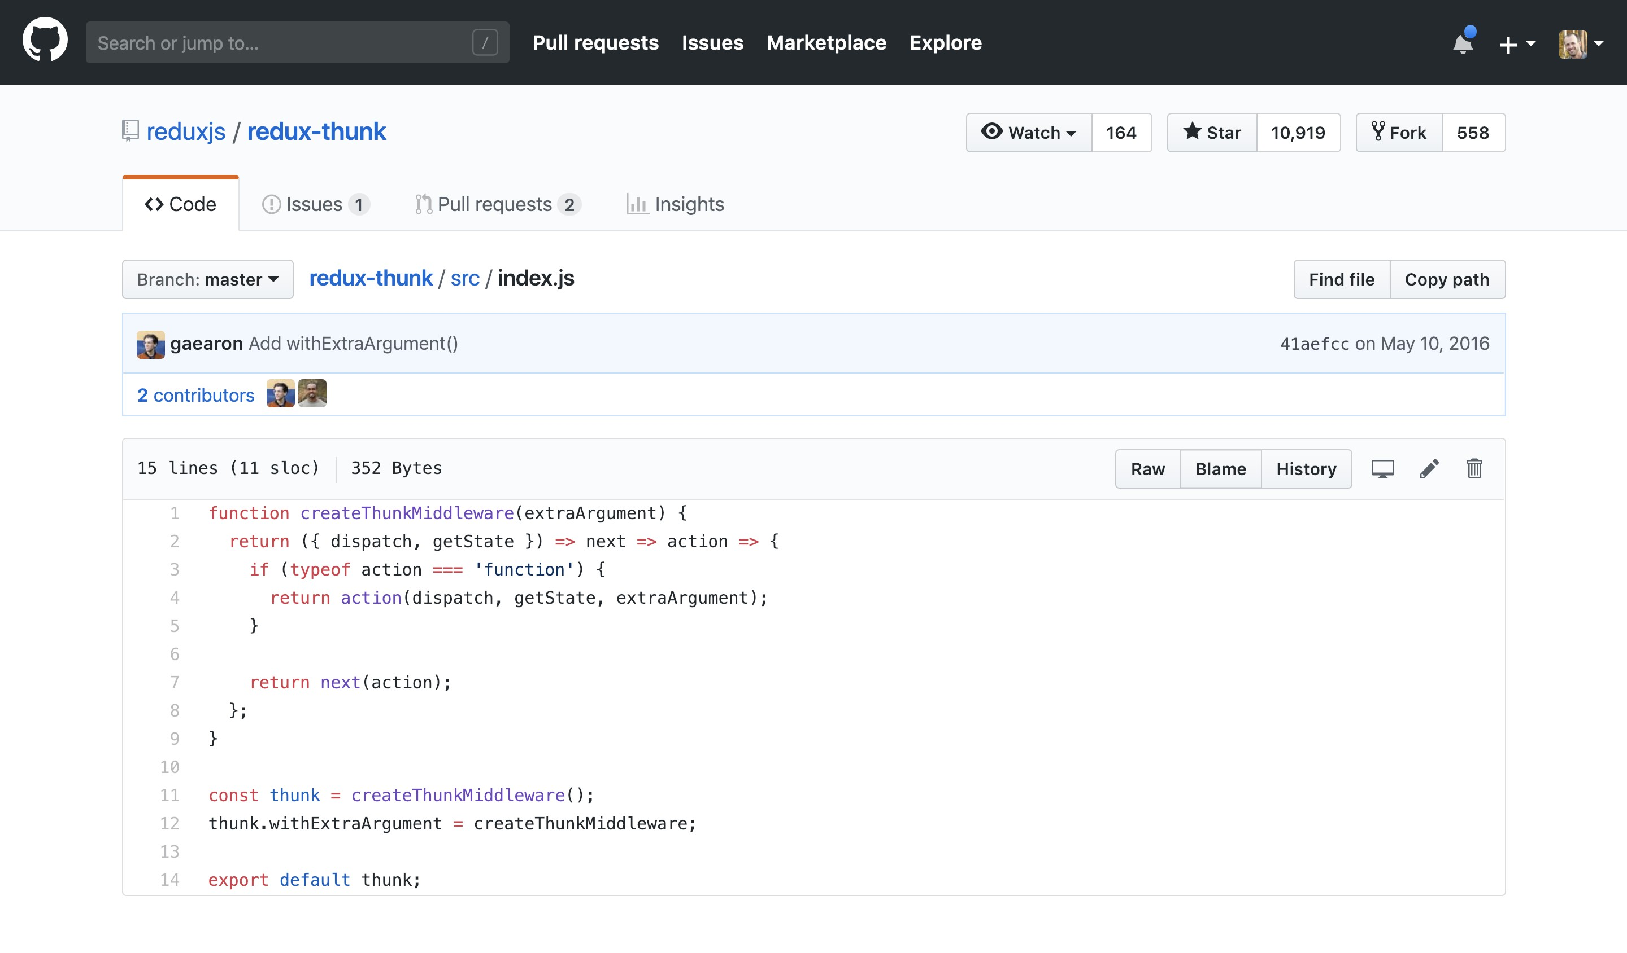

Slide 15







Slide 16
export function deleteAuthor(dispatch, authorId) { return AuthorApi.deleteAuthor(authorId)
.then(() => { dispatch(deletedAuthor(authorId));
})
.catch(handleError);
}

Slide 17






Slide 18




Slide 19

















-
-
-

